Slide 1

Vietnamese Social Media Emotion Corpus

Slide 2

Collecting data
1. Choosing three Vietnamese videos on YouTube with at least 100 comments. Crawling the first 100 comments of each videos.
Please find the Crawl Data Example.ipynb for an example of crawling.
2. Label these comments by yourself in seven classes: Disgust (chán ghét), Enjoyment(thích thú), Anger (giận dữ), Surprise (ngạc nhiên), Sadness (buồn bã), Fear (sợ hãi),Other (khác).

Slide 3
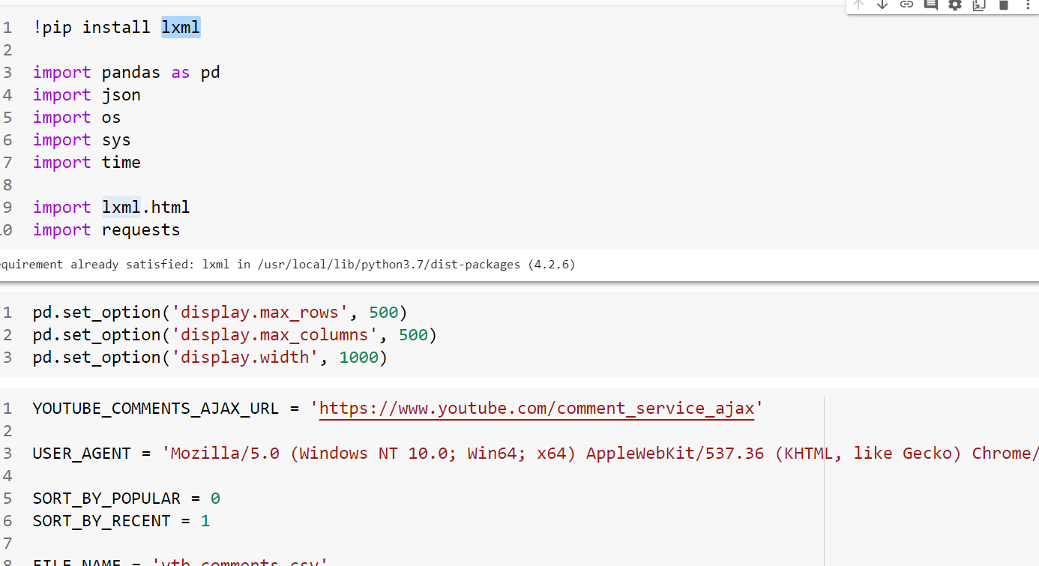
Get a random Youtube comment from a video without using the Youtube API

Slide 4
Use lxml
lxml is a Pythonic, mature binding for the libxml2 and libxslt libraries. It provides safe and convenient access to these libraries using the ElementTree API.
It extends the Element Tree API significantly to offer support for XPath, RelaxNG, XML Schema, XSLT, C14N and much more.

Slide 5
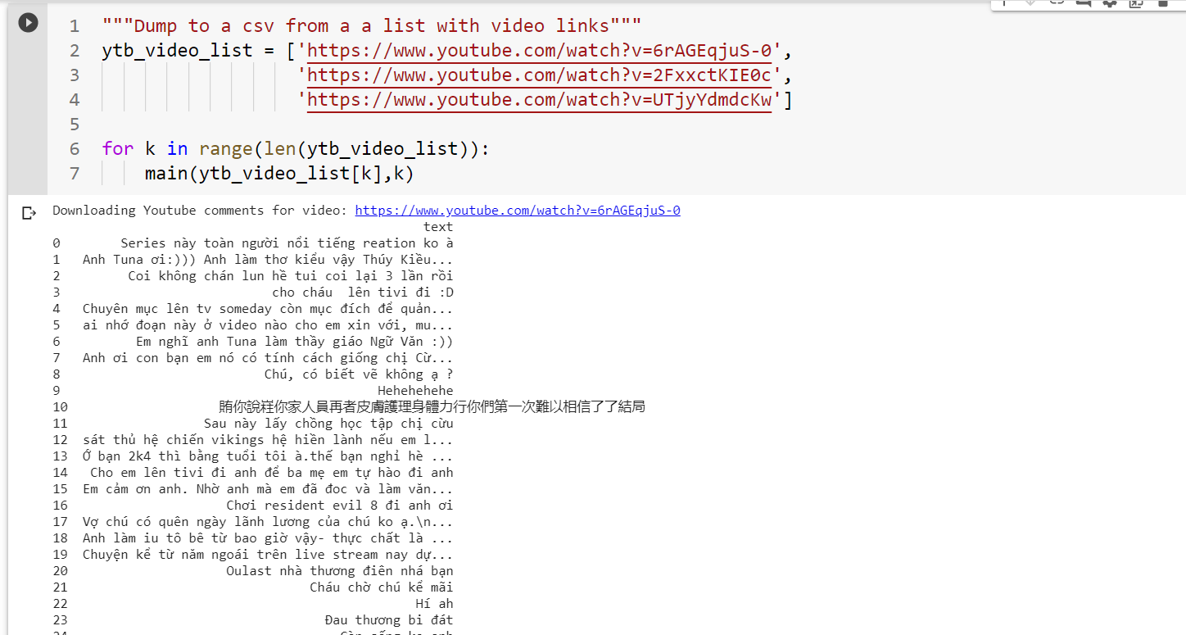

Slide 6
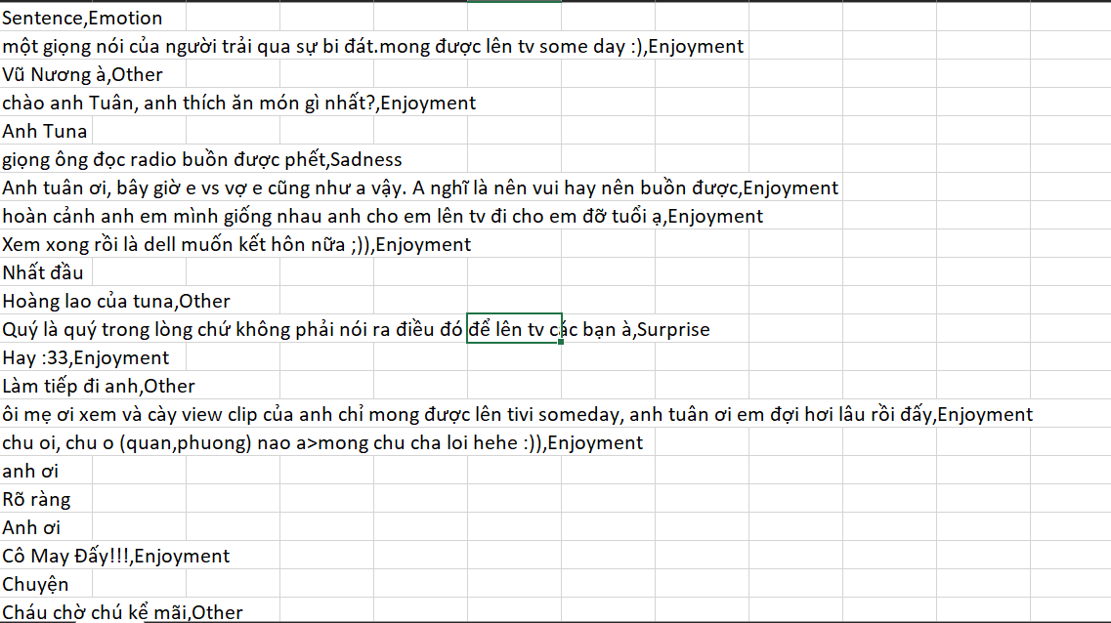

Slide 7

Task 2. (30%) Emotion Recognition for Vietnamese Social Media Text
1. Using training and validation sets of UIT-VSMEC (UIT-VSMEC.zip) for training your Emotion Recognition model (classification model).
Note: you can choose any technique in preprocessing, any classifier that you want.
2. Report the performance metrics (Accuracy, F1-score...) for the test set in UIT-VSMEC dataset.

Slide 8

Data collection and analysis

Slide 9
Table 1: Examples of emotion-labeled sentences.
No. | Vietnamese sentences | English translation | Emotion
1 | Ảnh đẹp quá! | The picture is so beautiful! | Enjoyment
2 | Tao khóc..huhu.. Tao rớt rồi | I’m crying..huhu.. I failed the exam. | Sadness
3 | Khuôn mặt của tên đó vẫn còn ám ảnh tao. | The face of that man still haunts me. | Fear
4 | Cái gì cơ? Bắt bỏ tù lũ khốn đó hết! | What the fuck? Arrest all those goddamn bastards! | Anger
5 | Thật không thể tin nổi, tại sao lại nhanh đến thế?? | It’s unbelievable, why can be that fast?? | Surprise
6 | Những điều nó nói làm tao buồn nôn. | What he said makes me puke. | Disgust

Slide 10

Table 2: Annotation agreement of the UIT-VSMEC corpus (%
Stage | Annotators | P0 | Pe | Am
1 | X1-X2-X3-Y (806 sentences) | 92.66 | 56.98 | 82.94
2 | X1-Y (2,032 sentences) | 88.00 | 18.61 | 85.25
 | X2-Y (2,112 sentences) | 86.27 | 31.23 | 80.03
 | X3-Y (1,977 sentences) | 92.81 | 33.95 | 89.12

Slide 11
Table 3: Statistics of emotion labels of the UIT-VSMEC corpus
Emotion | Sentences | Percentage (%)
Enjoyment | 1,965 | 28.36
Disgust | 1,338 | 19.31
Sadness | 1,149 | 16.59
Anger | 480 | 6.92
Fear | 395 | 5.70
Surprise | 309 | 4.46
Other | 1,291 | 18.66
Total | 6,927 | 100

Slide 12
Table 4: Distribution of emotion-annotated sentences according to the length of the sentence (%)
ength | Enjoyment | Disgust | Sadness | Anger | Fear | Surprise | Other | Overall
1-5 | 5.16 | 2.84 | 1.70 | 0.69 | 0.94 | 0.85 | 1.87 | 14.05
6-10 | 8.98 | 4.22 | 4.98 | 1.41 | 1.42 | 2.25 | 7.20 | 30.38
10-15 | 5.87 | 3.99 | 4.11 | 1.40 | 1.27 | 0.94 | 5.00 | 22.58
16-20 | 4.17 | 3.05 | 2.51 | 1.14 | 0.85 | 0.24 | 2.79 | 14.75
21-25 | 1.96 | 1.93 | 1.50 | 0.66 | 0.40 | 0.15 | 1.11 | 7.71
26-30 | 1.08 | 1.31 | 0.95 | 0.45 | 0.27 | 0.01 | 0.53 | 4.6
>30 | 1.23 | 1.97 | 0.84 | 1.17 | 0.55 | 0.02 | 0.15 | 5.93
Total | 28.36 | 19.31 | 16.59 | 6.92 | 5.70 | 4.46 | 18.66 | 100

Slide 13
Table 5: Experimental results by Orange3 of machine learning models on 1,000 emotion-annotated sentences from the UIT-VSMEC corpus (%)
Method | Accuracy | Weighted F1
Random Forest | 35.8 | 32.8
SVM | 37.6 | 37.0
Decision Tree | 30.5 | 29.6
kNN | 28.9 | 27.1
Naĩve Bayes | 20.8 | 19.2

Slide 14
Table 6: Vietnamese abbreviations in the dataset.
No. | Abbreviation | Vietnamese meaning | English meaning
1 | “dc” or “dk” or “duoc” | ”được” | ”ok”
2 | “ng” or “ngừi” | ”người” | ”people”
3 | ”trc” or ”trk” | ”trước” | ”before”
4 | ”cg” or ”cug” or ”cũg” | ”cũng” | ”also”
5 | ”mk” or ”mik” or ”mh” | ”mình” | ”I”

Slide 15
Table 7: Statistics of emotion-labeled sentences in training, validation and test sets.
Emotion | Train | Dev | Test | Total
Enjoyment | 1,573 | 205 | 187 | 1,965
Disgust | 1,064 | 141 | 133 | 1,338
Sadness | 938 | 92 | 119 | 1,149
Anger | 395 | 38 | 47 | 480
Fear | 317 | 38 | 47 | 395
Surprise | 242 | 36 | 31 | 309
Other | 1,019 | 132 | 140 | 1,291
All | 5,548 | 686 | 693 | 6,927

Slide 16
Table 8: Experimental results of the UIT-VSMEC corpus.
Corpus | Algorithm | Accuracy(%) | Weighted F1-Score(%)
Original | RandomForest+BoW | 50.64 | 40.11
 | SVM+BoW | 58.00 | 56.87
 | LSTM+word2Vec | 53.39 | 53.30
 | LSTM+fastText | 54.25 | 53.77
 | CNN+word2Vec | 59.74 | 59.74
 | CNN+fastText | 56.85 | 56.79
Without Other | RandomForest+BoW | 50.64 | 49.14
label | SVM+BoW | 63.12 | 62.45
 | LSTM+word2Vec | 61.70 | 61.09
 | LSTM+fastText | 62.06 | 61.83
 | CNN+word2Vec | 66.48 | 66.34
 | CNN+fastText | 63.47 | 62.68

Slide 17


Attention-based LSTM sentiment classifier.

Slide 18

Vectorization data

Slide 19

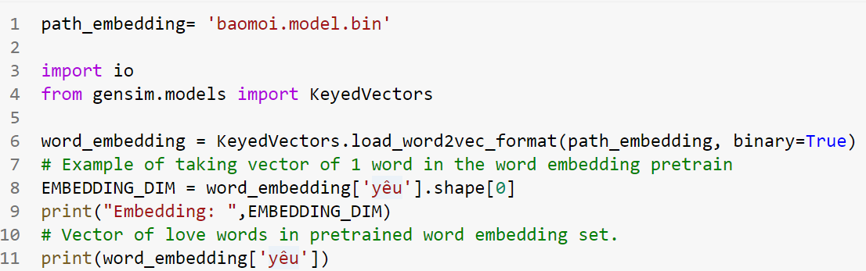
The technique I use here is word2vec, then comment2matrix. You can learn more about some other vector modeling methods for words or learn more about word2vec through my previous article here.
First, we proceed to create pre-trained word embedding using the gensim library:

Slide 20

Build and train a model

Slide 21
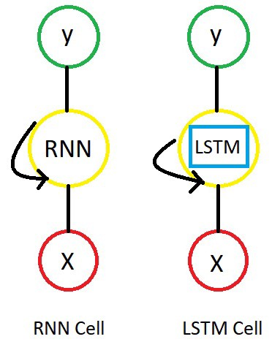
LTSM:
LTSM:
The Long Short-Term Memory network, or LSTM for short, is a type of recurrent neural network that achieves state-of-the-art results on challenging prediction problems.
Just like RNN, we have time steps in LSTM, but we have extra piece of information which is called “MEMORY” in LSTM cell for every time step.

Slide 22
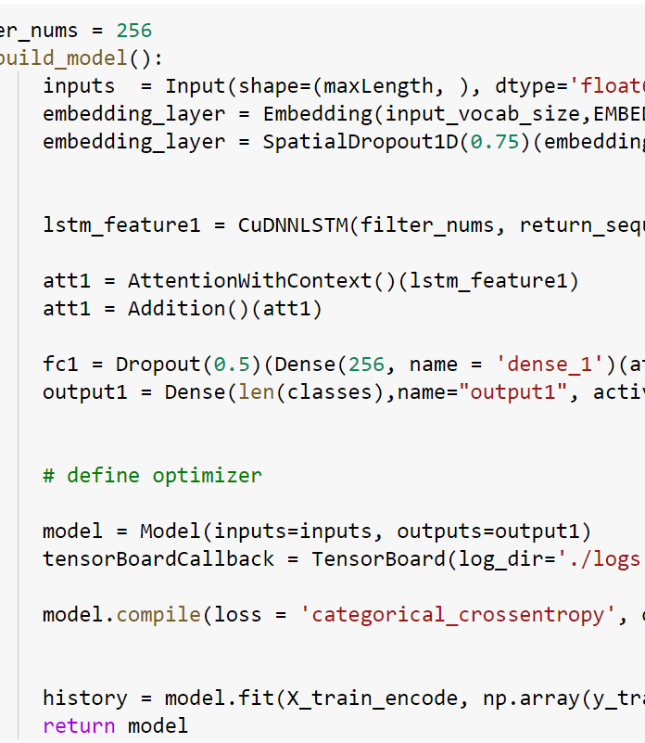
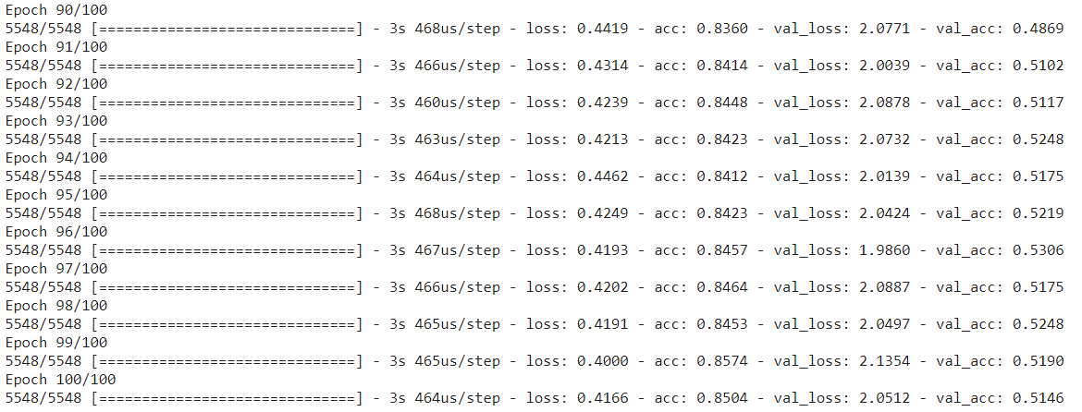

Slide 23
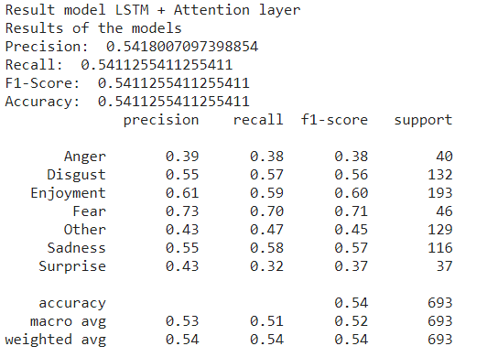
Report the performance metrics (Accuracy, F1-score...)

Slide 24
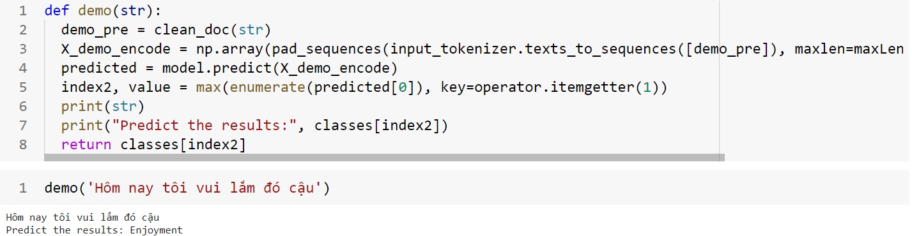
Enter the demo program into 1 sentence

Slide 25

Task 3. (30%) Applying the trained model in Task 2 to three datasets in Task 1. Then, report the performance metrics (Accuracy, F1-score...) for these datasets.

Slide 26

thank for listening

